Slide 1
Searching

Slide 2
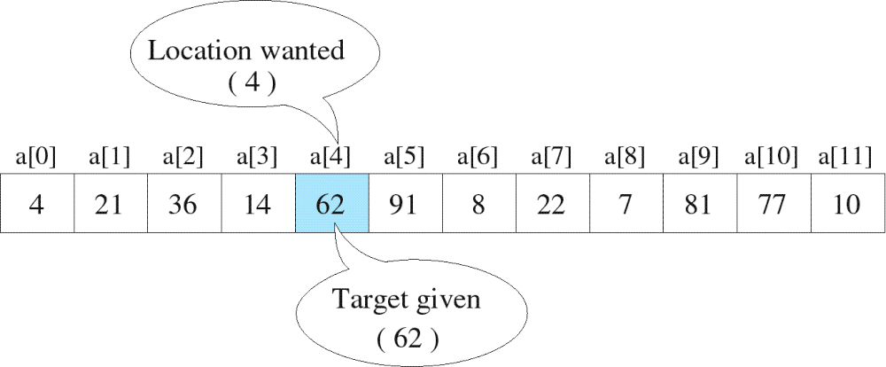
Searching
The process used to find the location of a target among a list of objects
  Searching an array finds the index of first element in an array containing that value

Slide 3
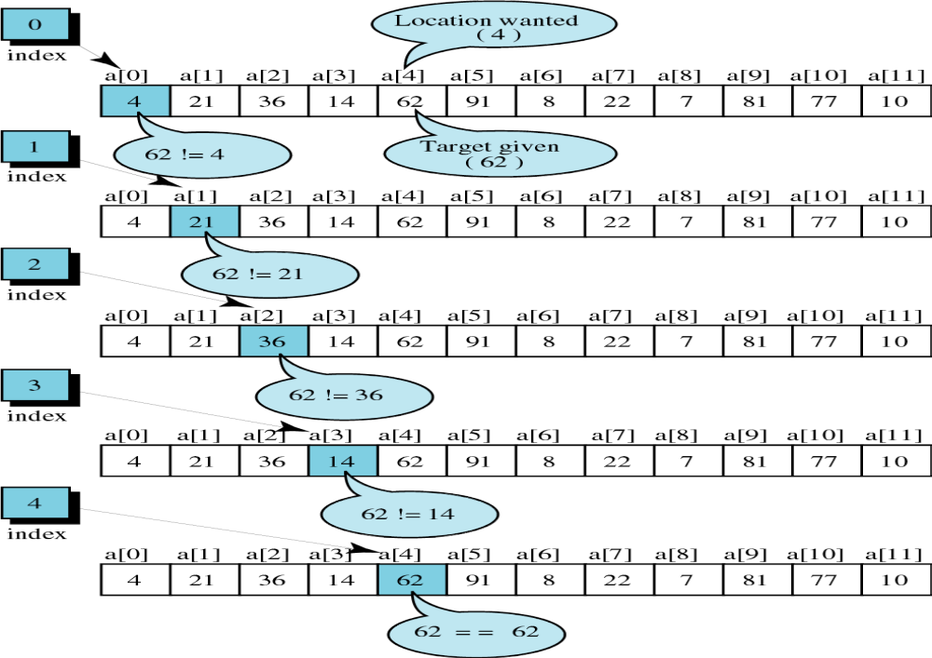
successful

Slide 4
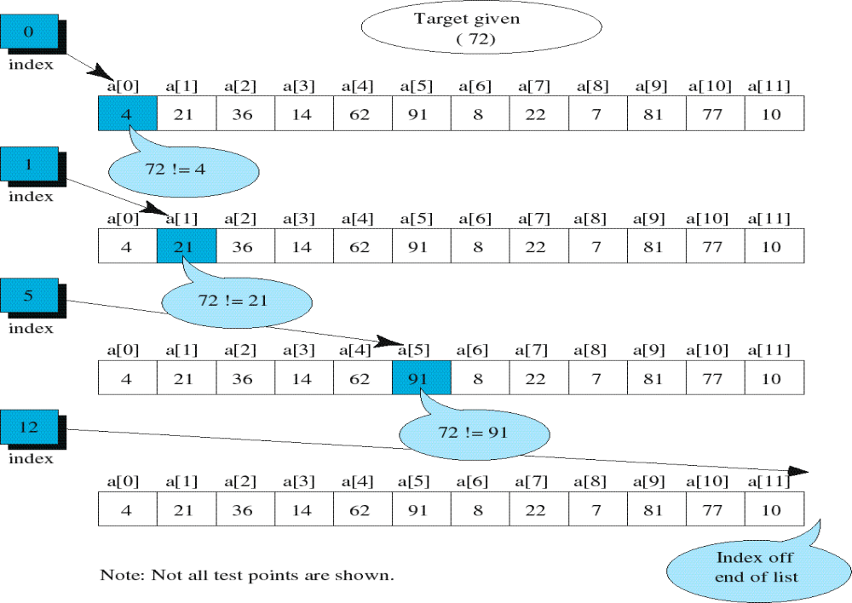
unsuccessful

Slide 5
Unordered Linear Search
Search an unordered array of integers for a value and return its index if the value is found. Otherwise, return -1.
A[0] A[1] A[2] A[3] A[4] A[5] A[6] A[7]
Algorithm:
Start with the first array element (index 0)
while(more elements in array){
if value found at current index, return index;
Try next element (increment index);
}
Value not found, return -1;
14 2 10 5 1 3 17 2

Slide 6
Unordered Linear Search
// Searches an unordered array of integers
int search(int data[], //input: array
int size, //input: array size
int value){ //input: search value
// output: if found, return index;
// otherwise, return –1.
for(int index = 0; index < size; index++){
if(data[index] == value)
return index;
}
return -1;
}

Slide 7
Binary Search
Binary search. Given value and sorted array a[], find index i
such that a[i] = value, or report that no such index exists.
Invariant. Algorithm maintains a[lo] ≤ value ≤ a[hi].
Ex. Binary search for 33.
6
13
14
25
33
43
51
53
64
72
84
93
95
96
97
0
1
2
3
4
5
6
7
8
9
10
11
12
13
14
lo
hi

Slide 8
Binary Search
Binary search. Given value and sorted array a[], find index i
such that a[i] = value, or report that no such index exists.
Invariant. Algorithm maintains a[lo] ≤ value ≤ a[hi].
Ex. Binary search for 33.
6
13
14
25
33
43
51
53
64
72
84
93
95
96
97
0
1
2
3
4
5
6
7
8
9
10
11
12
13
14
lo
mid
hi

Slide 9
Binary Search
Binary search. Given value and sorted array a[], find index i
such that a[i] = value, or report that no such index exists.
Invariant. Algorithm maintains a[lo] ≤ value ≤ a[hi].
Ex. Binary search for 33.
6
13
14
25
33
43
51
53
64
72
84
93
95
96
97
0
1
2
3
4
5
6
7
8
9
10
11
12
13
14
lo
hi

Slide 10
Binary Search
Binary search. Given value and sorted array a[], find index i
such that a[i] = value, or report that no such index exists.
Invariant. Algorithm maintains a[lo] ≤ value ≤ a[hi].
Ex. Binary search for 33.
6
13
14
25
33
43
51
53
64
72
84
93
95
96
97
0
1
2
3
4
5
6
7
8
9
10
11
12
13
14
lo
mid
hi

Slide 11
Binary Search
Binary search. Given value and sorted array a[], find index i
such that a[i] = value, or report that no such index exists.
Invariant. Algorithm maintains a[lo] ≤ value ≤ a[hi].
Ex. Binary search for 33.
6
13
14
25
33
43
51
53
64
72
84
93
95
96
97
0
1
2
3
4
5
6
7
8
9
10
11
12
13
14
lo
hi

Slide 12
Binary Search
Binary search. Given value and sorted array a[], find index i
such that a[i] = value, or report that no such index exists.
Invariant. Algorithm maintains a[lo] ≤ value ≤ a[hi].
Ex. Binary search for 33.
6
13
14
25
33
43
51
53
64
72
84
93
95
96
97
0
1
2
3
4
5
6
7
8
9
10
11
12
13
14
lo
mid
hi

Slide 13
Binary Search
Binary search. Given value and sorted array a[], find index i
such that a[i] = value, or report that no such index exists.
Invariant. Algorithm maintains a[lo] ≤ value ≤ a[hi].
Ex. Binary search for 33.
6
13
14
25
33
43
51
53
64
72
84
93
95
96
97
0
1
2
3
4
5
6
7
8
9
10
11
12
13
14
lo
hi

Slide 14
Binary Search
Binary search. Given value and sorted array a[], find index i
such that a[i] = value, or report that no such index exists.
Invariant. Algorithm maintains a[lo] ≤ value ≤ a[hi].
Ex. Binary search for 33.
6
13
14
25
33
43
51
53
64
72
84
93
95
96
97
0
1
2
3
4
5
6
7
8
9
10
11
12
13
14
lo
hi
mid

Slide 15
Binary Search
Binary search. Given value and sorted array a[], find index i
such that a[i] = value, or report that no such index exists.
Invariant. Algorithm maintains a[lo] ≤ value ≤ a[hi].
Ex. Binary search for 33.
6
13
14
25
33
43
51
53
64
72
84
93
95
96
97
0
1
2
3
4
5
6
7
8
9
10
11
12
13
14
lo
hi
mid

Slide 16
Example: Binary Search
Searching for an element k in a sorted array A with n elements
Idea:
  Choose the middle element A[n/2]
  If k == A[n/2], we are done
  If k < A[n/2], search for k between A[0] and A[n/2 -1]
  If k > A[n/2], search for k between A[n/2 + 1] and A[n-1]
  Repeat until either k is found, or no more elements to search
Requires less number of comparisons than linear search in the worst case (log₂n instead of n)

Slide 17
int main() {
int A[100], n, k, i, mid, low, high;
scanf(“%d %d”, &n, &k);
for (i=0; i<n; ++i)
scanf(“%d”, &A[i]);
low = 0; high = n – 1; mid = (high + low)/2;
while (high >= low)
{ if (A[mid] == k) {
printf(“%d is found\n”, k);
break;
}
if (k < A[mid])
high = mid – 1;
else
low = mid + 1;
mid = (high + low)/2;
}
If (high < low) printf(“%d is not found\n”, k);
}

Slide 18
Sorting

Slide 19
Bubble Sort
Bubble Sort is a simple algorithm which is used to sort a given set of n elements provided in form of an array with n number of elements. Bubble Sort compares all the element one by one and sort them based on their values.
If the given array has to be sorted in ascending order, then bubble sort will start by comparing the first element of the array with the second element, if the first element is greater than the second element, it will swap both the elements, and then move on to compare the second and the third element, and so on.
If we have total n elements, then we need to repeat this process for n-1 times.
It is known as bubble sort, because with every complete iteration the largest element in the given array, bubbles up towards the last place or the highest index, just like a water bubble rises up to the water surface.
Sorting takes place by stepping through all the elements one-by-one and comparing it with the adjacent element and swapping them if required.
Easier to implement, but slower than Insertion sort

Slide 20
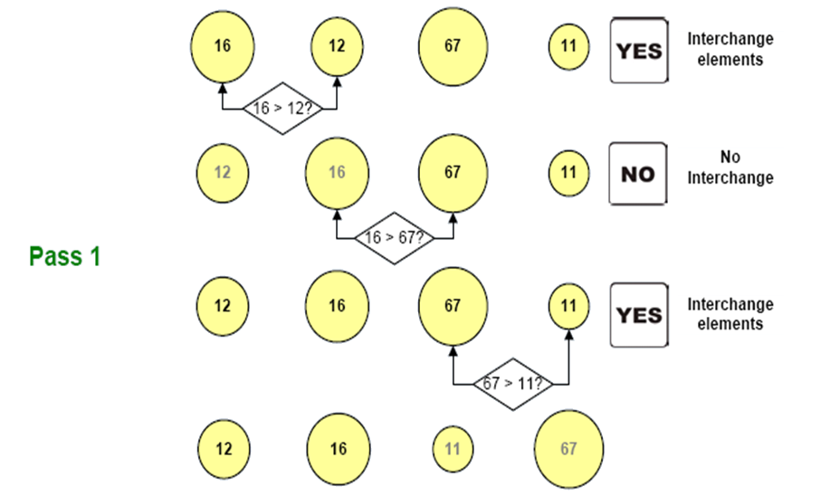
Bubble Sort- Illustration

Slide 21
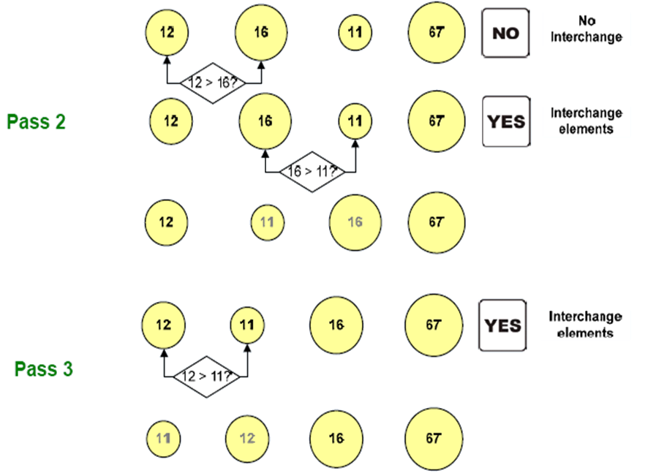
Bubble Sort- Illustration

Slide 22
Pseudo code for Bubble Sort procedure
for(i=0;i<n;i++)
Input a[i]; // entered elements
for(i=0;i<n-1;i++) //pass
{ for(j=0;j<n-i-1;j++)
{ if(a[j]>a[j+1]) // comparison
{ // interchange
temp=a[j];
a[j]=a[j+1];
a[j+1]=temp;
}
}
}
Example :
a[ ]={16, 12, 11, 67}
Array after sorting (ascending) a[ ]={11, 12, 16, 67}

Slide 23
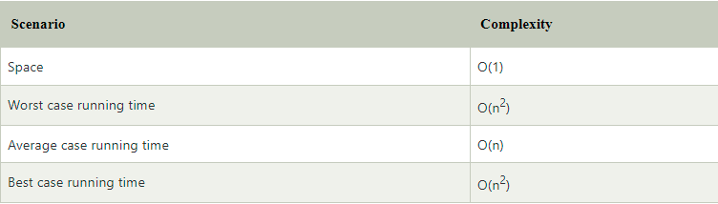
Complexity

Slide 24
Selection Sort
Idea:
  Find the smallest element in the array
  Exchange it with the element in the first position
  Find the second smallest element and exchange it with the element in the second position
  Continue until the array is sorted
Disadvantage:
  Running time depends only slightly on the amount of order in the file
  This algorithm is not suitable for large data sets as its average and worst case complexities are of Ο(n²), where n is the number of items.

Slide 25
Example
8 | 4 | 6 | 9 | 2 | 3 | 1
1 | 2 | 3 | 4 | 9 | 6 | 8
1 | 4 | 6 | 9 | 2 | 3 | 8
1 | 2 | 3 | 4 | 6 | 9 | 8
1 | 2 | 6 | 9 | 4 | 3 | 8
1 | 2 | 3 | 4 | 6 | 8 | 9
1 | 2 | 3 | 9 | 4 | 6 | 8
1 | 2 | 3 | 4 | 6 | 8 | 9

Slide 26
Selection Sort
Alg.: SELECTION-SORT(A)
n ← length[A]
for j ← 0 to n - 1
do smallest ← j
for i ← j + 1 to n
do if A[i] < A[smallest]
then smallest ← i
exchange A[j] ↔ A[smallest]
8 | 4 | 6 | 9 | 2 | 3 | 1

Slide 27
A,n
for (k=0; k<n-1; k++)
{ min= A[K]
loc= k
for(j=k+1; j<n ; j++)
{ if min> a[j]
{ min = a[j]
loc = j
}
}
swap(A[K], A[loc])
}

Slide 28
Complexity
Also, we can analyze the complexity by simply observing the number of loops. There are 2 loops so the complexity is n*n=n².
Worst Case Complexity O(n²) : If we want to sort in ascending order and the array is in descending order then, the worst case occurs.
Best Case Complexity O(n²) : It occurs when the array is already sorted
Average Case Complexity O(n²) : It occurs when the elements of the array are in jumbled order (neither ascending nor descending).
The time complexity of the selection sort is the same in all cases. At every step, you have to find the minimum element and put it in the right place. The minimum element is not known until the end of the array is not reached.
Space Complexity:
Space complexity is O(1) because an extra variable temp is used

Slide 29
Insertion Sort
Idea: like sorting a hand of playing cards
  Start with an empty left hand and the cards facing down on the table.
  Remove one card at a time from the table, and insert it into the correct position in the left hand
    compare it with each of the cards already in the hand, from right to left
  The cards held in the left hand are sorted
    these cards were originally the top cards of the pile on the table

Slide 30
Insertion Sort
To insert 12, we need to make room for it by moving first 36 and then 24.
6
10
24
36
12

Slide 31
Insertion Sort
6
10
24
36
12

Slide 32
Insertion Sort
6
10
24
36
12

Slide 33

Insertion Sort
input array
5 2 4 6 1 3
at each iteration, the array is divided in two sub-arrays:
left sub-array
right sub-array
sorted
unsorted

Slide 34





Insertion Sort

Slide 35
INSERTION-SORT
Alg.: INSERTION-SORT(A)
for j ← 2 to n
do key ← A[ j ]
Insert A[ j ] into the sorted sequence A[1 . . j -1]
i ← j - 1
while i > 0 and A[i] > key
do A[i + 1] ← A[i]
i ← i – 1
A[i + 1] ← key
Insertion sort – sorts the elements in place
Animation: https://yongdanielliang.github.io/animation/web/InsertionSortNew.html
1
2
3
4
5
6
7
8
a₁
a₂
a₃
a₄
a₅
a₆
a₇
a₈
key

Slide 36
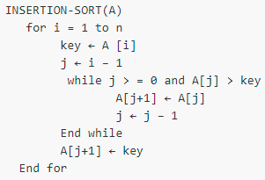
Psedu Code-
Sort(int a[], int n)
{
int i, j, key;
for(i=1; i<n; i++)
{ key = a[i];
  j=i-1;
while(j>=0 && a[j]>key)
{ a[j+1] = a[j];
j=j-1
}
a[j+1] = key;
}
}

Slide 37

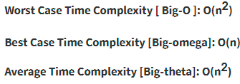
Complexity
Even though insertion sort is efficient, still, if we provide an already sorted array to the insertion sort algorithm, it will still execute the outer for loop, thereby requiring n steps to sort an already sorted array of n elements, which makes its best case time complexity a linear function of n.
Wherein for an unsorted array, it takes for an element to compare with all the other elements which mean every n element compared with all other n elements. Thus, making it for n x n, i.e., n² comparisons.

